Slide 1
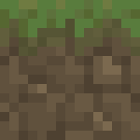
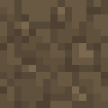
Team TBD
Zach Madison, Solomon Preston,
Alex Peters, and Adonis Lattimore.
Artist: Joshua Sykes

Slide 2
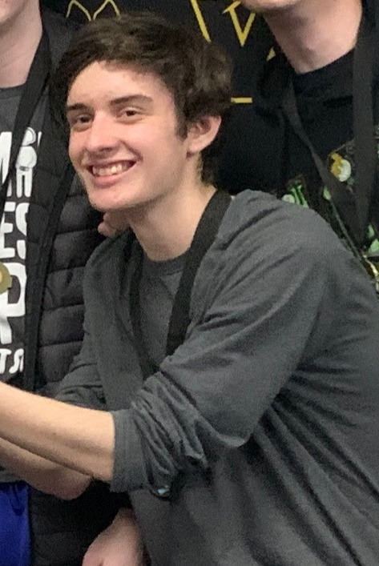
Involved Artist into project
Artist: Joshua Sykes
Involvement includes
Creation of various sprites
Tile-map
Stage Assets
Creation of animations

Slide 3
Week Two Iteration Goals
A stage for the user to play
Hazards for the player to avoid
Animated player character
Moving Camera

Slide 4
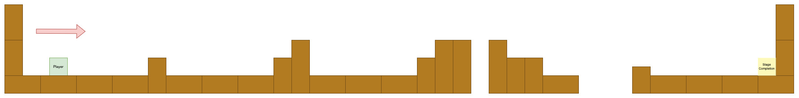
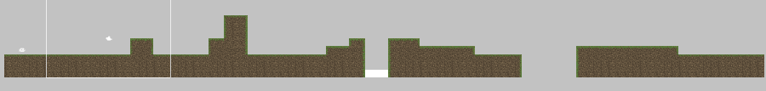
Stage Design/Implementation

Slide 5
Completed Iteration Two
Stage one designed and created in Unity
Camera now follows player
Player character animations added
Hazards can kill the player
Respawn implemented
Checkpoint framework created
Movement improved
Fixed interactions not working as intended
Added wall-jump

Slide 6
Team TBD
Demonstration

